Slide 1

Creating Base Windows
William Roberts
9/1/2025

Slide 2
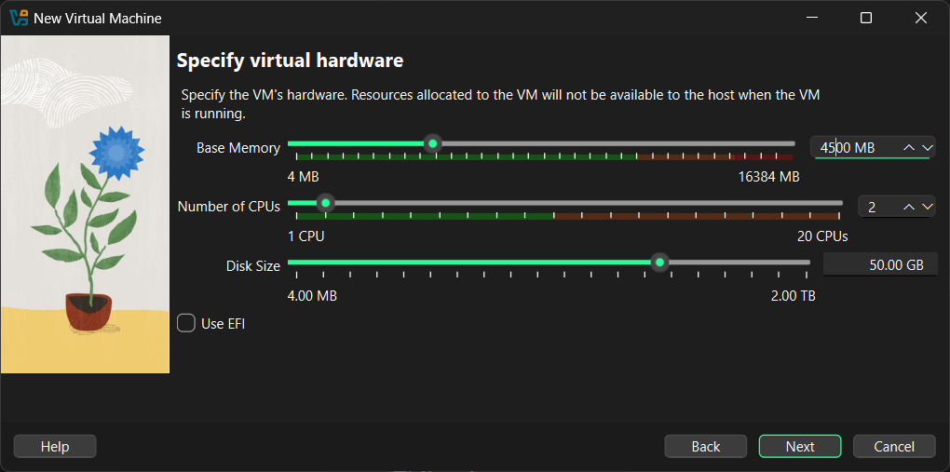
Memory, RAM and Disk size followed

Slide 3
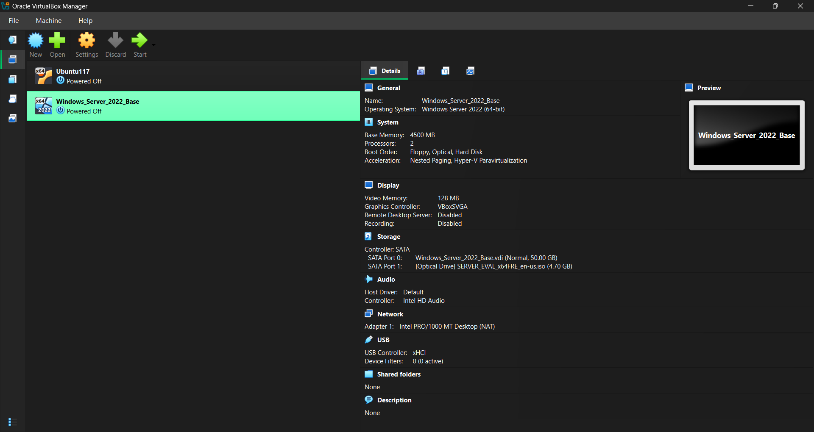
Machine has been created

Slide 4
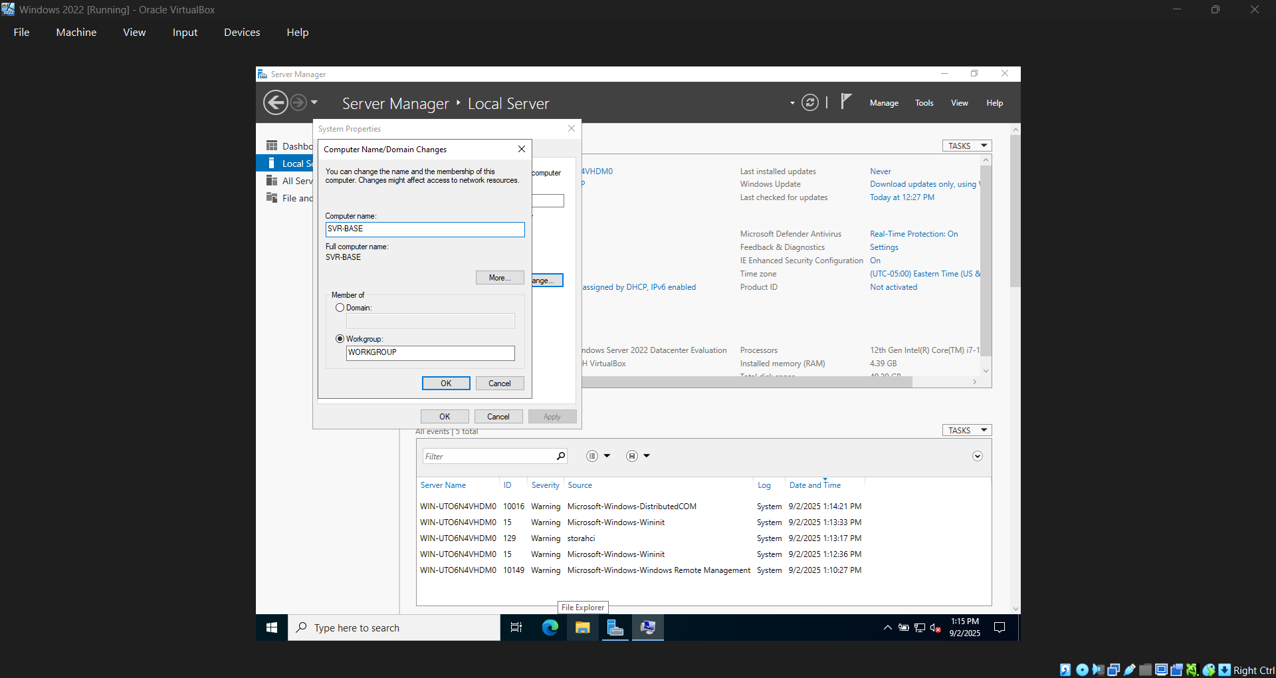
Renamed to SVR-BASE

Slide 5
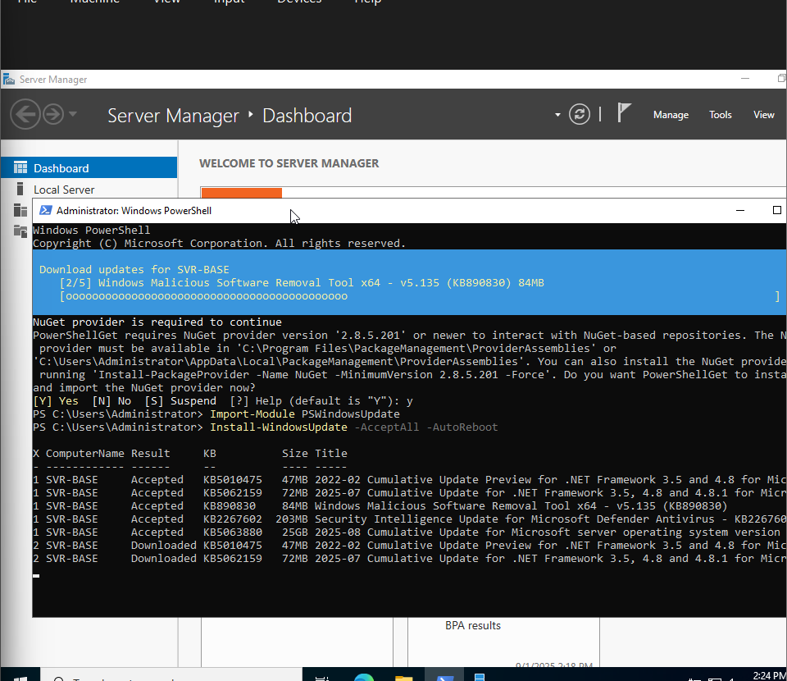
Updating Windows

Slide 6
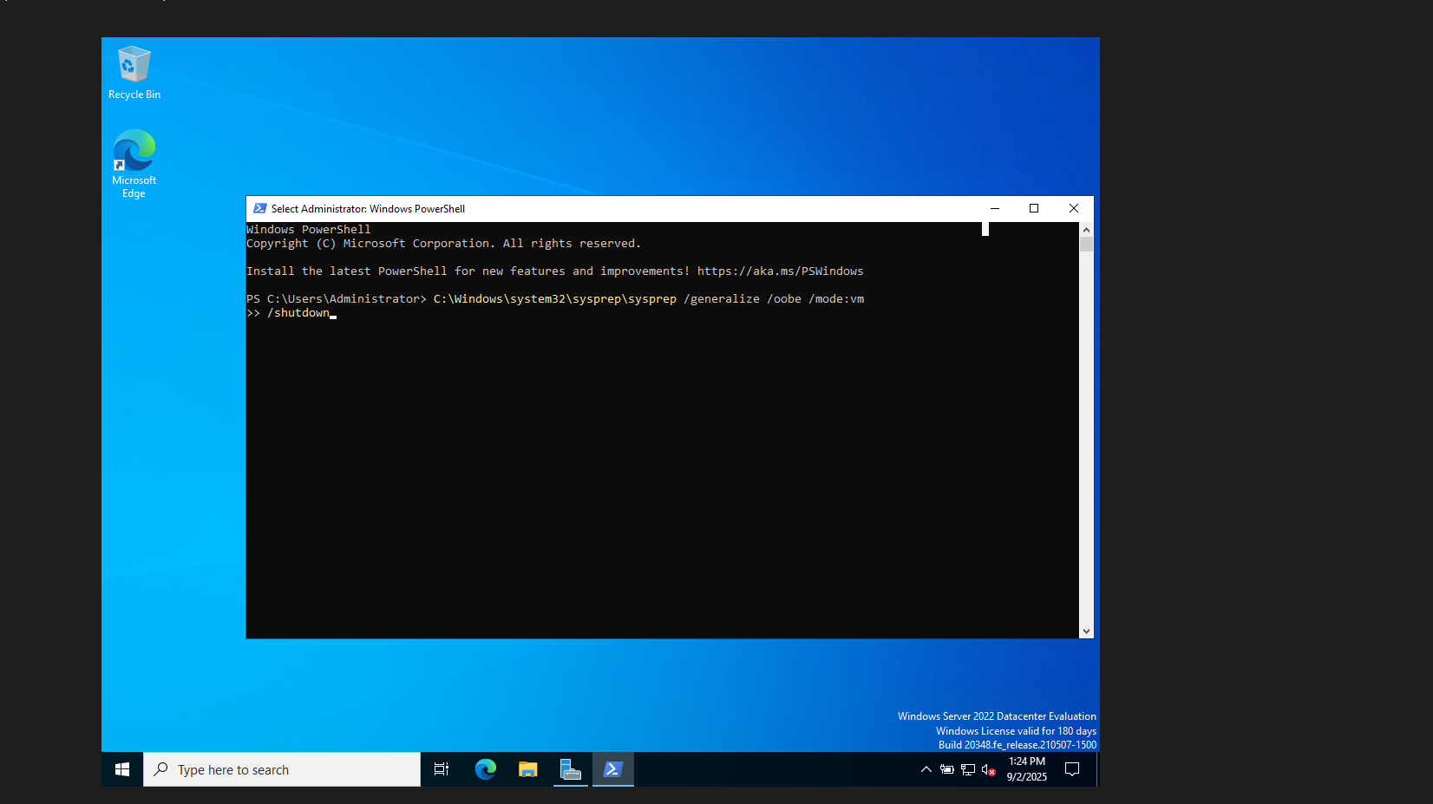
Prepare Base Image

Slide 7
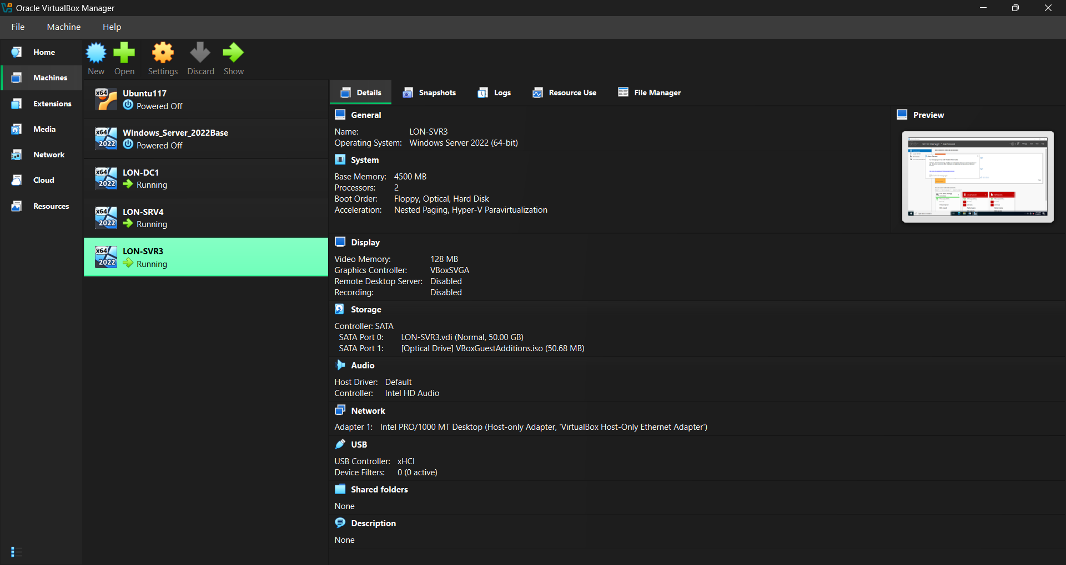
Cloned

Slide 8
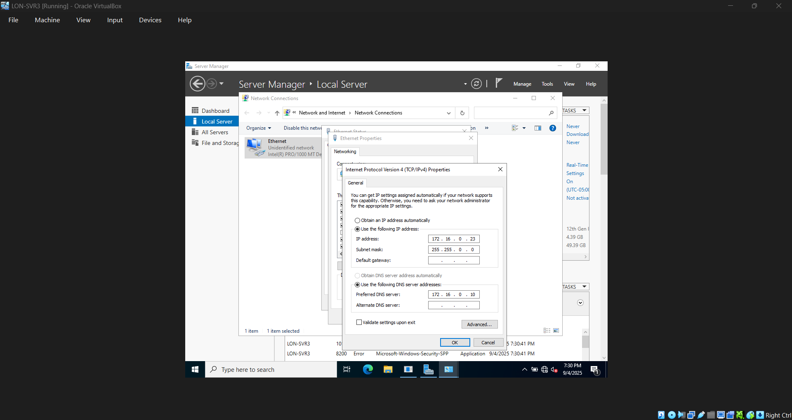

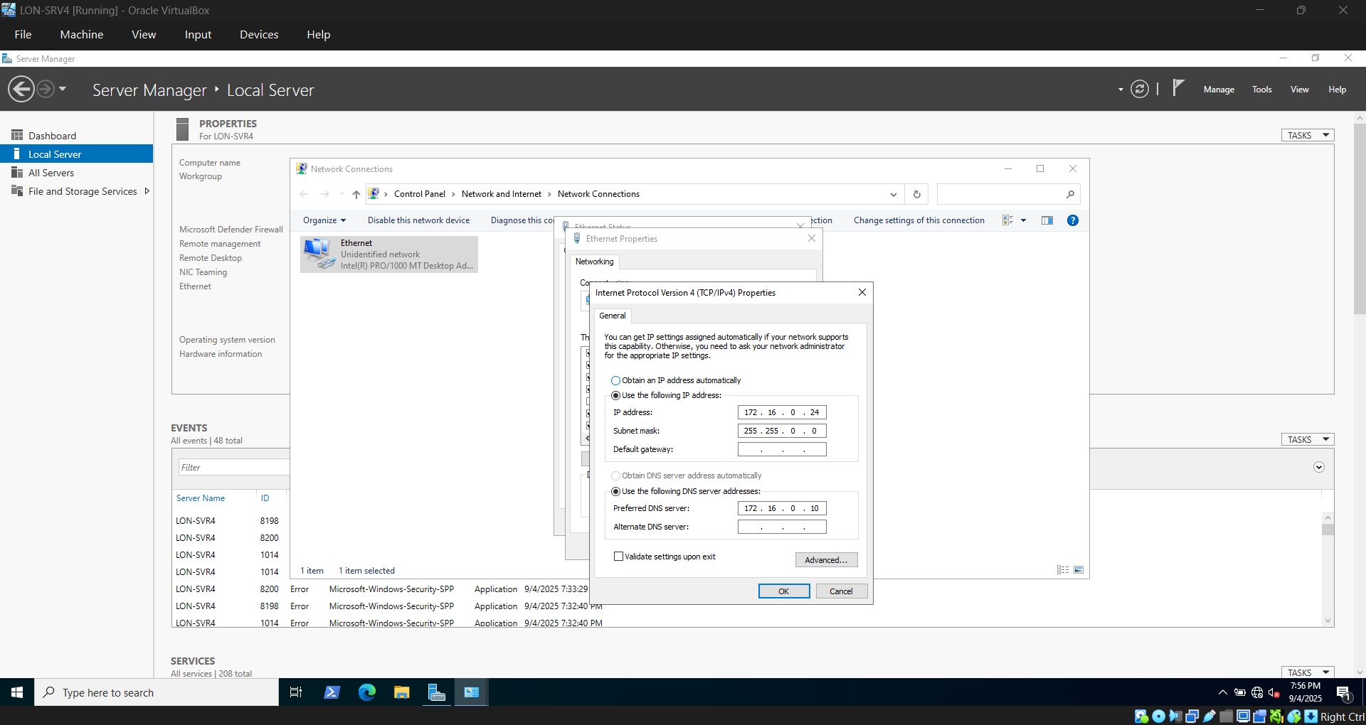
IP Address

Slide 9
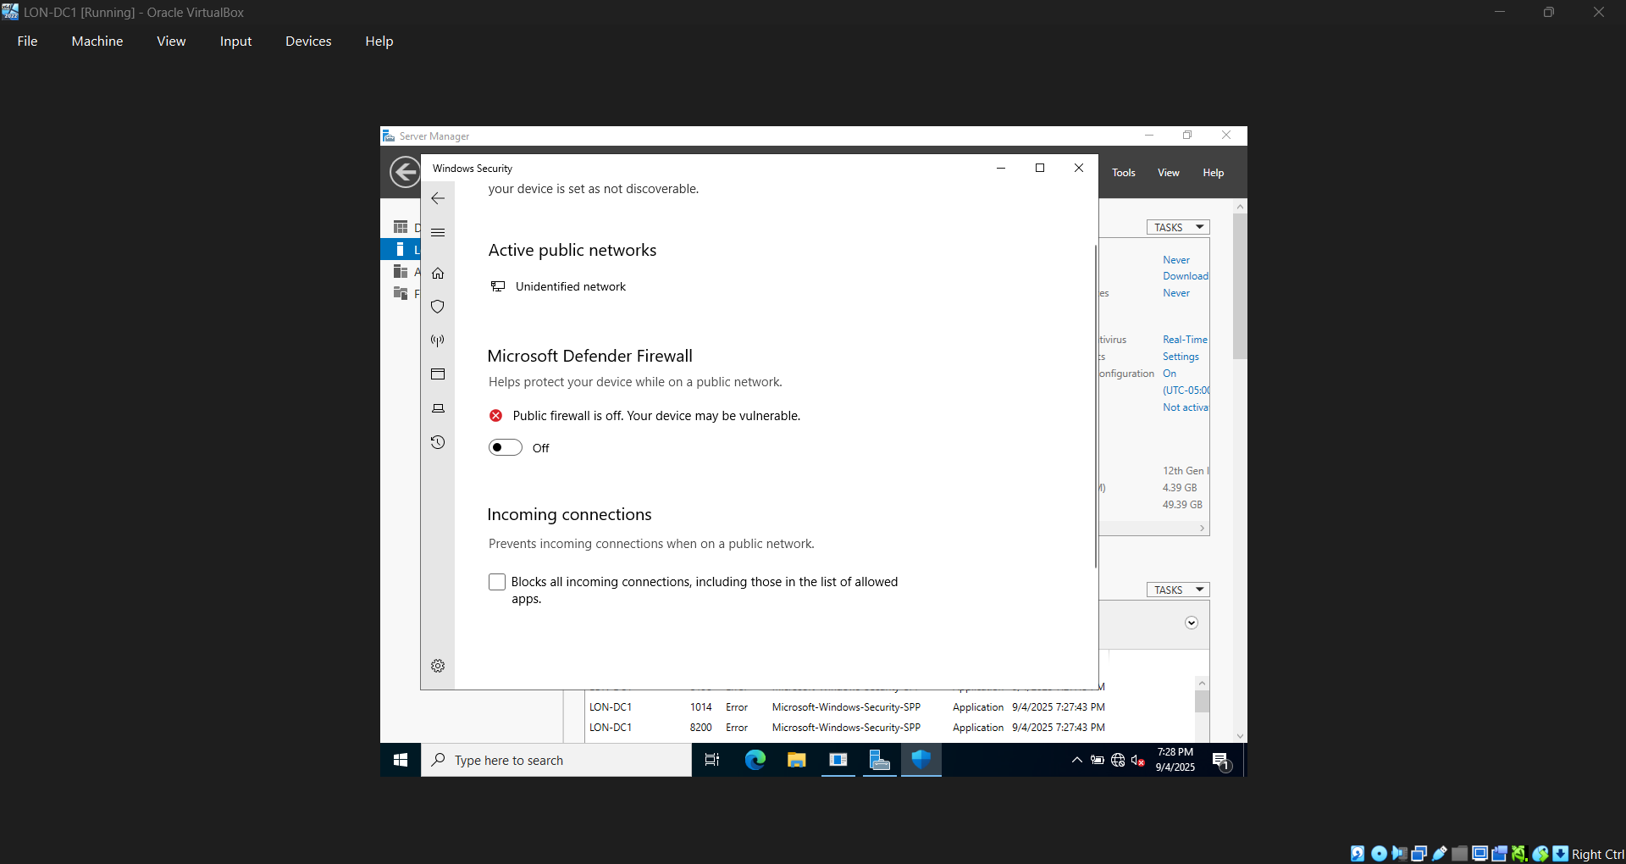
Firewalls Down

Slide 10
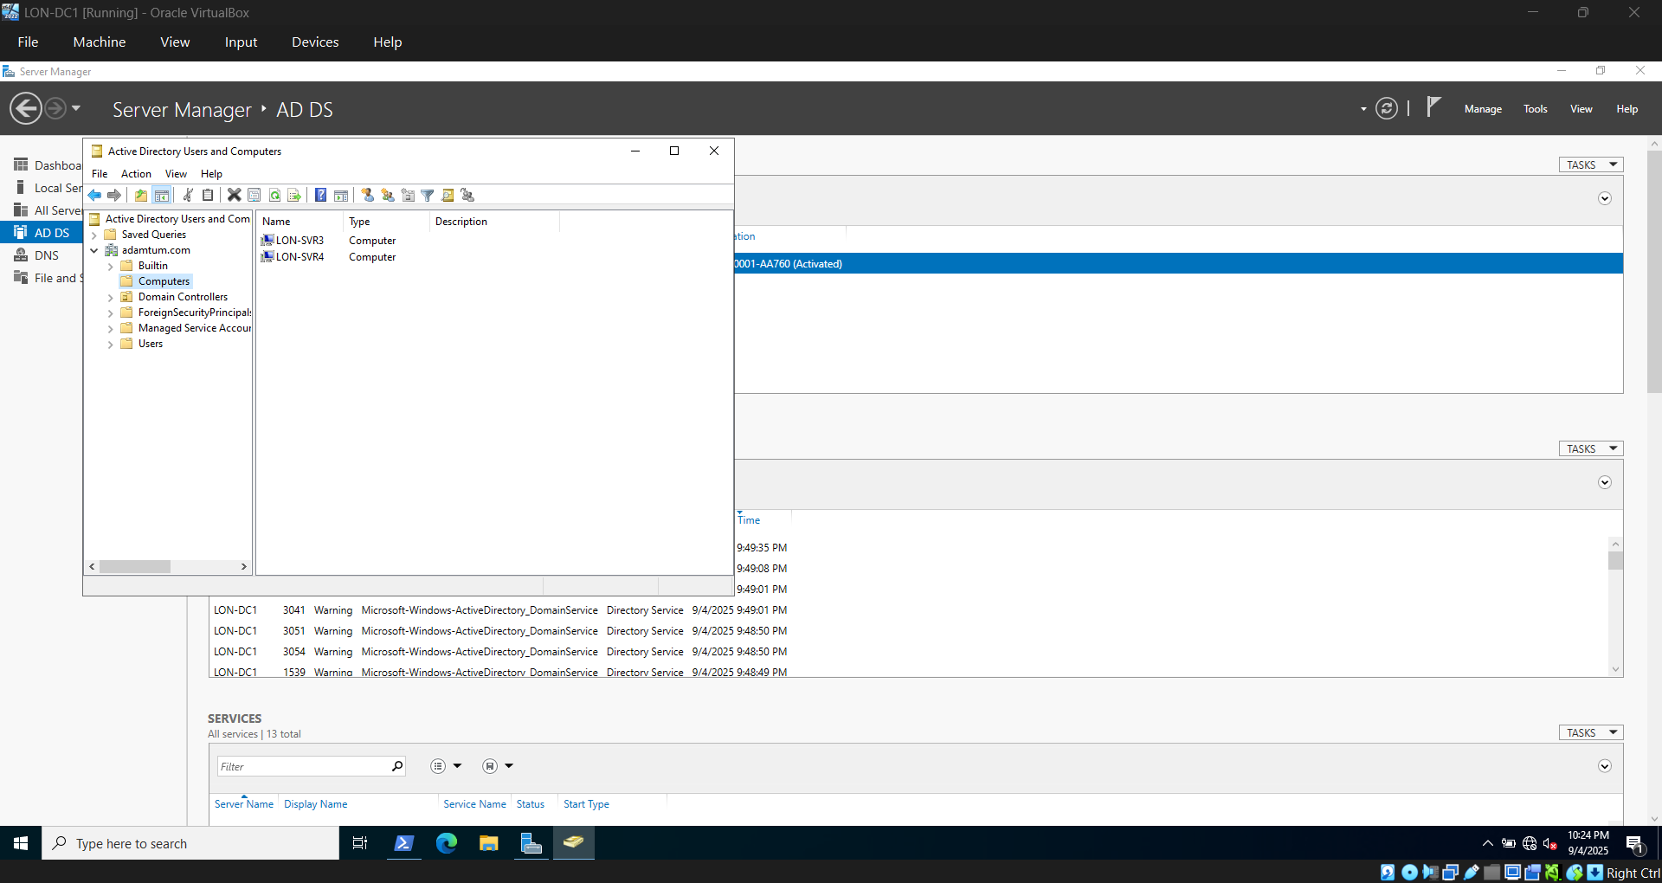
All Three on Domain

